Slide 1
A Functional Language for Parallel Computing
Zhenbang You
3/16/2023
https://github.com/ZhenbangYou/A-Functional-Language-for-Parallel-Computing

Slide 2
Goal and Roadmap
Design and embed a DSL in Scala3
Generate CUDA code
Keep APIs functional and easy-to-use
Try to bridge the performance gap
Performance
Safety
Productivity
Ideal

Slide 3
Goal and Roadmap
Design and embed a DSL in Scala3
Generate CUDA code
Keep APIs functional and easy-to-use
Try to bridge the performance gap
During the design and implementation, I am discovering more and more issues to be resolved
Performance
Safety
Productivity
In Reality

Slide 4
Pipeline
Functional DSL
(Embedded in Scala3)
Run Scala Program
CUDA Code
(Global and Device Functions)
Compile & Run on GPU
Final Result

Slide 5
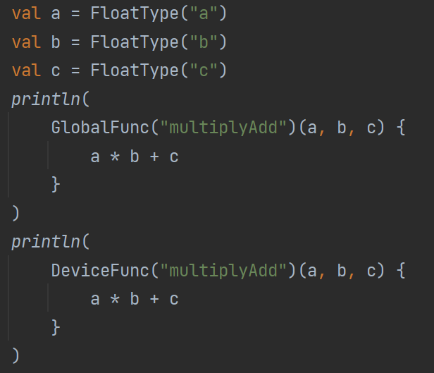
The First Tough Issue: Expression-Oriented to Statement-Oriented
It seems fine for scalar variables

Slide 6
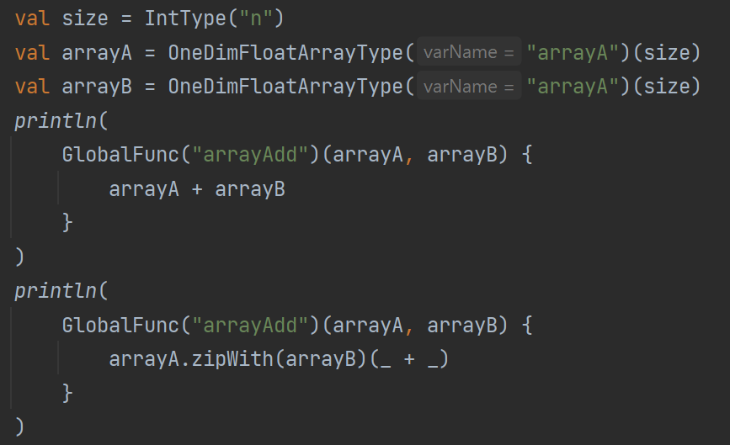
The First Tough Issue: Expression-Oriented to Statement-Oriented
What about array operations?

Slide 7
Intermediate Representations to Rescue
Two levels of IRs
Higher one: ExprIR (Expression IR), expression-oriented
Lower one: StmtIR (Statement IR), statement-oriented
Overloaded Operators
“genStatement” method
“codeGen” method
Source
Code
ExprIR
StmtIR
CUDA Code
(Text Format)

Slide 8
Type Safety & Type Hierarchy
Purely functional
Generic design
Type for both DSL syntax and development of the compiler

Slide 9
Memory Safety

Slide 10
Memory Hierarchy

Slide 11
Synchronization

Slide 12
Still a Long Way to Go …

